Slide 1
Outcomes-Based Funding: The National Context, Design Principles & Research
Louisiana Formula Summit August 3, 2016
Jimmy Clarke, Ph.D.

Slide 2
Open platform for leaders and influencers in all 50 states to share research and data, encourage peer learning and professional experiences to advance Goal 2025.
Notes:
20 action items based on unique state needs

Slide 3
Lumina Stronger nation: The Louisiana Context

Slide 4
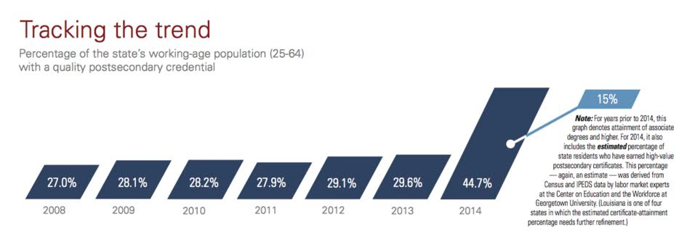
Lumina Stronger Nation: Louisiana
Notes:
Which includes an attainment goal “…to raise the percentage of Kentuckians with a high-quality postsecondary degree or certificate from its current level of 45% to 58% by the year 2025…”
Increase -

Slide 5
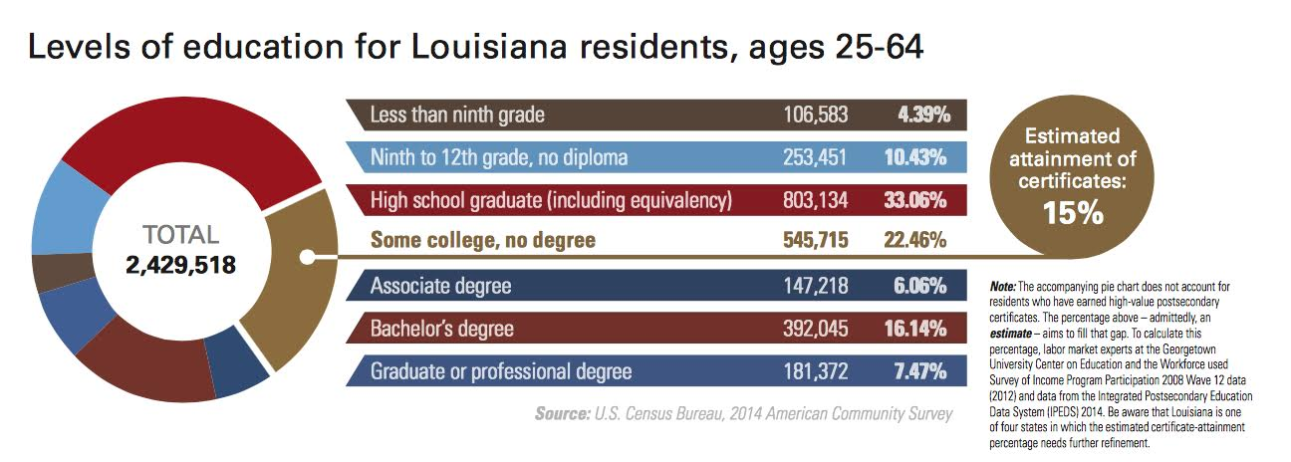
Lumina Stronger Nation: Louisiana

Slide 6
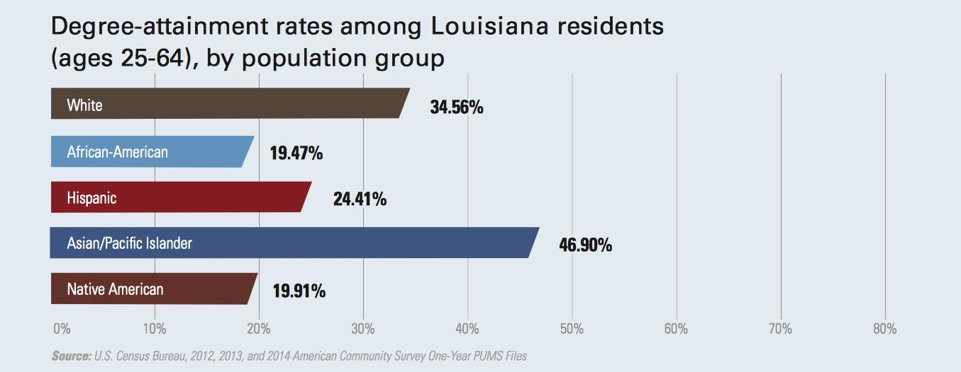
Lumina Stronger Nation: Louisiana

Slide 7
Outcomes-Based Funding: Linking Resources to outcomes, Design Principles, Common Metrics

Slide 8
Policy Rationale for Outcomes-Based Funding
Align funding method with state/system priorities
Align institution priorities
Support Scaling of Proven Student Success Practices
Programmatic Evaluation and Change
Improve Efficiency & Reward Outcomes
Completion/Attainment
Jobs/Economic Development

Slide 9
Design Principles for Outcomes-Based Funding
Begin with a state goal/clear policy priorities
Use a simple approach
All public institutions included, reflect mission
Incent success of typically underrepresented students
Make the money meaningful
Seek Stakeholder Input
Phase-in (≠ Hold Harmless)
Include only measurable metrics
Plan to evaluate
Notes:
Begin with state goal – CPE Stronger By Degrees 58%, Pritchard Committee Report 62%
Simple Approach – limit complexity and crate capacity for institutions to incorporate completion and outcomes into business model
Measureable Metrics – use data that you trust and that is meaningful – avoid the temptation to pull in everything that you want – and have only what you need
Underrepresented Students – focus on those areas where you want/need improvement – the smaller the amount of OBF/PBF the more you should lean into the measures you are most interested in moving.
All public institutions – important to bring all institutions into the fold and have a congruent focus aligned with the state’s needs
Stakeholder input – bring together all effected parties, get the right technical and facilitation support and have a clear timeframe – input doesn’t mean consensus, it means input.
Make the money meaningful – discuss business model – create positive ROI equation
Phase-in – make clear transition pathway and allow institutions to plan accordingly. Don’t flip the switch, but move quickly. The more the $ the more you need a transition. If small amounts – you can move quickly. Look at the overall delta.
Create evaluation period – you will need to tighten in some areas and loosen in others. Don’t be afraid of this and establish a system to evaluate effectiveness

Slide 10
Common Measures
Type of Measures | Examples
Student Progression and Momentum Intermediate outcomes/key milestones important to student’s progression toward completion | Remedial education success Completion of first college-level mathematics and English courses Credit accumulation (e.g. 15, 30 credit hours)
Completion & Outcomes Promote certificate, degree completion, transfer | Number or rate of program completers Number of transfers Job Placement
Productivity & Institution Mission Promote efficiency, affordability and focusing dollars on core mission functions | Degrees per 100 FTE Research Workforce Training
Priority Student categories and/or degree types that are a priority for the state to meet attainment and job needs. Student focus is on progression and completion, not just access. | Adult students Academically underprepared students Low-income (Pell-eligible) students Minority students STEM-H degrees Note: often reflected by providing an extra weight to progression and completion metrics

Slide 11
Implementation of OBF
Phase in the effect of funding change
Continuously improve data
Evaluate & Adjust

Slide 12
Challenges for States
Development
Engaging stakeholders/securing commitment
Technical sophistication
Balance limited metrics with different institutional missions
Implementation
Date and level of implementation not specified from outset
Perpetual pilot
Sustainability
New dollars only

Slide 13
National Context: Outcomes-Based Funding Typology

Slide 14
Development of Outcomes-Based Funding Typology
Effort to classify outcomes-based funding policies on key elements and funding levels:
Link to attainment or completion goal
Stable and formula-driven funding structure
Significant level of funding
All public institutions included
Differentiation of metrics across sectors
Degree/credential completion is included
Encourages increased success with underserved students
Sustained funding over consecutive years

Slide 15
Typology Classification Some states may meet most but not all criteria. States that do not meet all criteria for a level are assigned a lower type. Items in green italics are primary differences from prior level
TYPE I
No attainment/completion goal
TYPE II
Completion or attainment goal in place
TYPE III
Completion or attainment goal in place
TYPE IV
New-money only
Degree completion not included
Underrepresented student success not reflected
Recurring dollars/base funding at least portion of funding source
Does not include all institutions
Does not include all institutions
Degree completion included
Underrepresented students may be prioritized
Part of general allocation
All institutions included
Differentiation in metrics
Degree completion included
Underrepresented students are prioritized
Completion or attainment goal in place
Part of general allocation
Significant funding (>25%)
< 5% of overall support
Moderate funding level (5-24.9%)
All institutions included
Differentiation in metrics
Degree completion
Underrepresented students are prioritized
Sustained for two or more consecutive years
< 5% of overall support, based on statewide analysis
Target/recapture approach
May not have been sustained for 2 or more consecutive years
May not have been sustained for 2 or more consecutive years
May not be formula driven
Not sustained for two or more consecutive years
Formula driven
Target/recapture approach likely
More reflective of early PBF 1.0 models
Reflect robust OBF 2.0 models

Slide 16
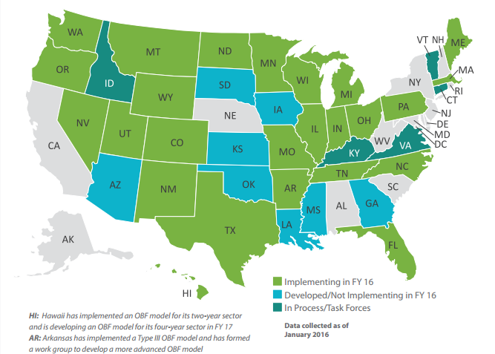
States Developing and Implementing Outcomes-Based Funding Models
Notes:
As of Fiscal Year 2016 30 states (60%) have either implemented (25 states) OBF or are developing (5 states) OBF.

Slide 17
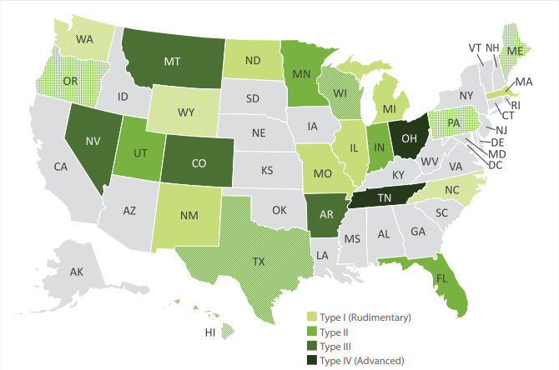
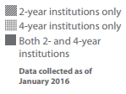
States Implementing OBF in FY 16 by Type & Sector

Slide 18
Funding Associated with OBF Models
Wide variation in funding in scope, structure and sophistication in state funding models
Outcomes funding formulas are comprised of four general components:
Progression and degree completion
Course completion
Mission funding
Non-OBF/other funding
In many states, outcomes funding remains a small portion of state support to institutions

Slide 19
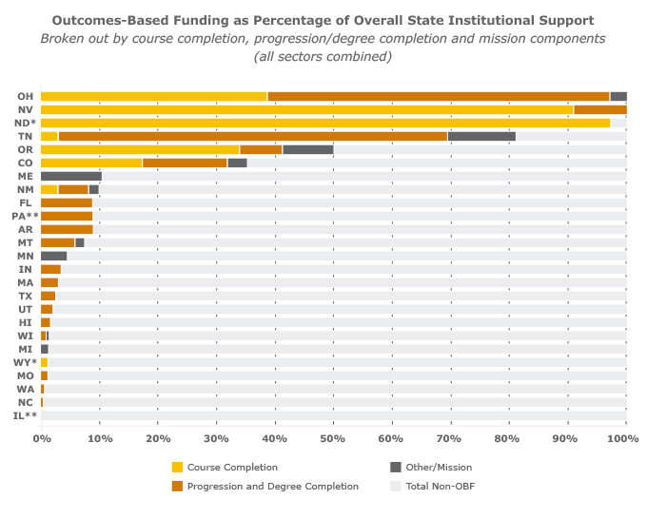
ME, OR, PA have OBF in 4-year sector only,
(2) NC, TX, WA, WI, WY have OBF in 2-year sector only
*Course-completion only; no other measures such as degree completion are included
** Have not passed FY 2016 budgets and are operating on Continuing Resolutions. Data presented are from FY 2015Course-completion only; no other measures such as degree completion are included.

Slide 20
Outcomes-Based Funding: Research & Effectiveness

Slide 21
Outcomes-Based Funding: Research & Impacts
Focused mostly on 1.0 policies; beginning to track impact on 2.0 policies
Research is almost entirely focused on intermediate (institutional change) impacts
Limited information/ability to understand ultimate impact (scarce research)

Slide 22
Research and Impacts
Change in colleges’ awareness of state priorities & own performance
Reported increase in use of data in institutional planning
Academic program improvements
Academic departments: staffing and structure changes
Academic delivery: program structure (remedial education)
Student Services
Integrated registration, financial aid
Targeted student advising, tutoring and supplemental services
Concerns
Lowering academic quality to increase outcomes
Instability of funding (due to new money only)

Slide 23
Research on the Horizon
Research for Action
Gates and Lumina supported
Mixed-Methods study
Focused on IN, OH and TN
Attempts to account for design and implementation distinctions
Implementation
Changes in policy over time
Level of funding (OBF and state investment as component of institutional profile)
Early findings:
OBF positively associated with bachelor’s degree completions
Counters some earlier research that OBF negatively affects access for Pell students
Significant response (though varied) by institutions

Slide 24
Focusing on Next Steps

Slide 25
Understanding State Investments
Provide transparent information on all state higher education finance policies
Examine, collectively and individually, all elements of state finance policies
Institution allocation
Tuition
Student Financial Aid
Support institutions to evaluate and understand student outcomes and the programmatic, financial and policy changes required

Slide 26
StrategyLabs.LuminaFoundation.org
Notes:
We invite you to check out strategylabs.luminafoundation.org, bookmark it and send us your feedback. Of course, we hope you recommend the site to others!
Sharing real time policy information is important to drive this agenda….but it’s the actions taken that ultimately improve attainment. I am pleased to join two higher education champions on this panel with me today who are focused on improved attainment for ALL students. They have rolled up their sleeves to get the needed work done to improve their results and I look forward to hearing from them.

