Slide 1

Outcomes Based Formula Summit
August 3, 2016
Pennington Biomedical Research Center

Slide 2
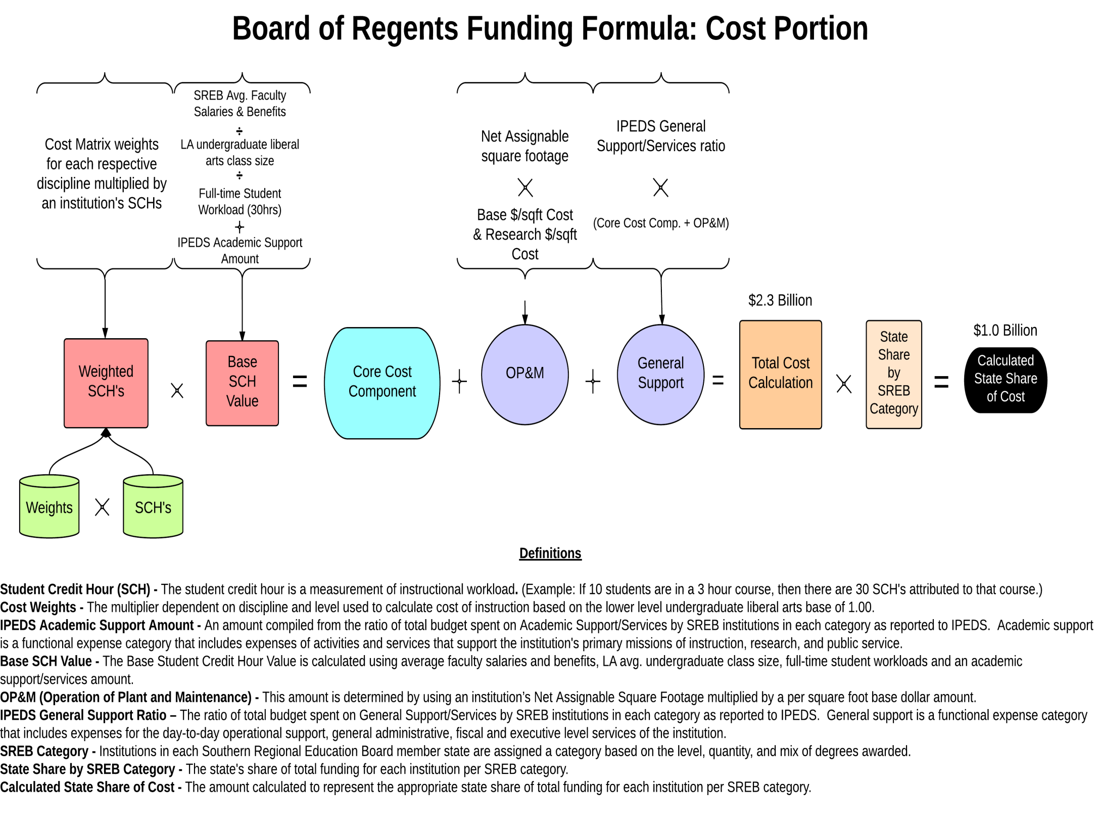
2

Slide 3
3

Slide 4
4

Slide 5
5

Slide 6
6

Slide 7
7

Slide 8
8

Slide 9
SREB Categories
9

Slide 10
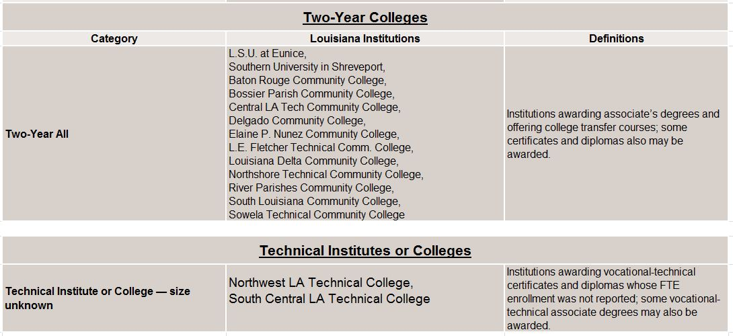
SREB Categories
10

Slide 11
Page 11

Slide 12
Outcomes Portion
12

Slide 13
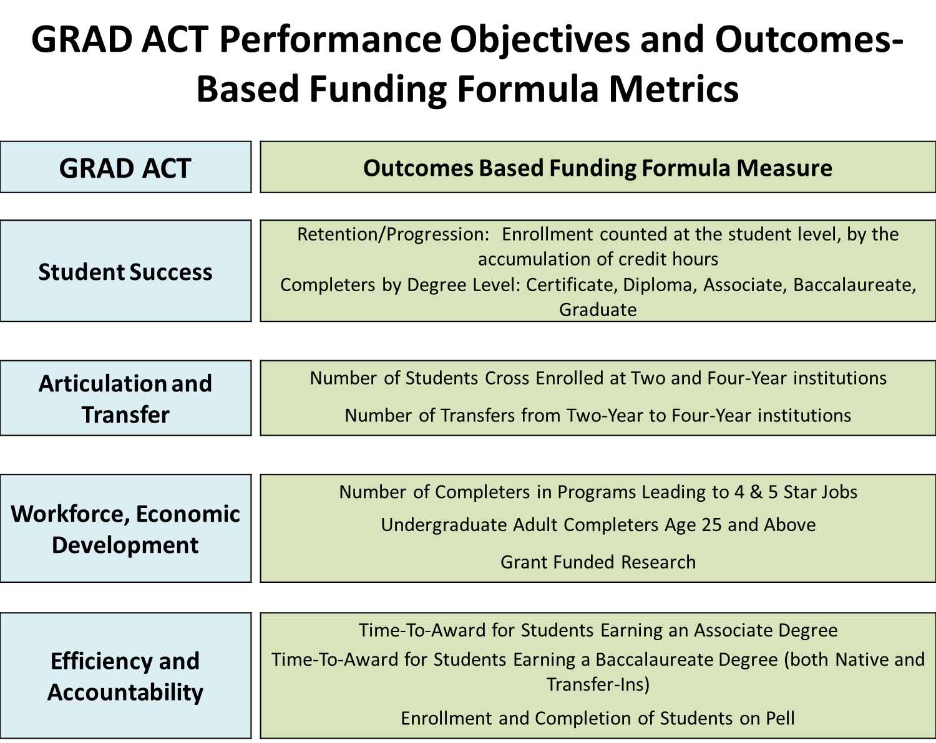
13

Slide 14
14

Slide 15
15

Slide 16
16

